Slide 1
GCN for Dependency Parsing
November 6th 2019

Slide 2
Outline
Background
Task Definition
Graph-based Dependency Parsing with Graph Neural Networks

Slide 3
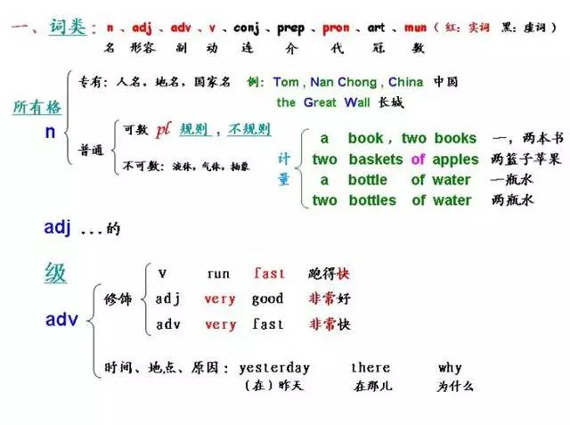

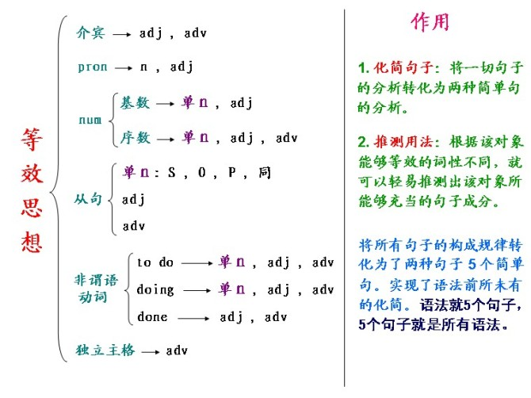
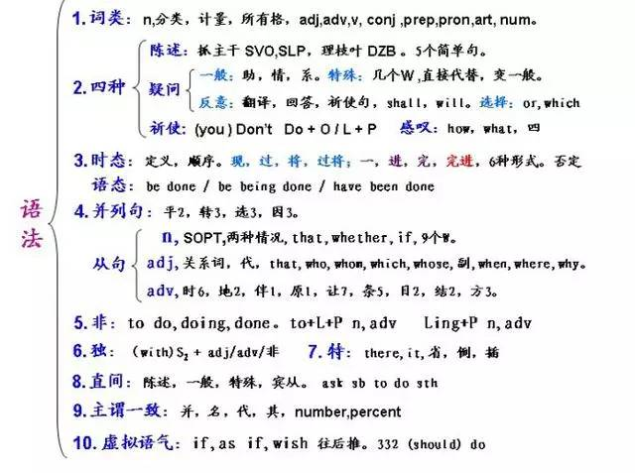
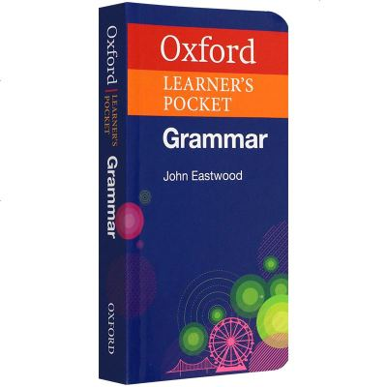

1. Syntax
The word syntax comes from the Greek syntaxis , meaning “setting out together or arrangement”, and refers to the way words are arranged together.
Jurafsky, Daniel, and James H. Martin. "Speech and Language Processing: An introduction to speech recognition, computational linguistics and natural language processing." Upper Saddle River, NJ: Prentice Hall (2008).
http://www.sohu.com/a/74710386_356310

Slide 4
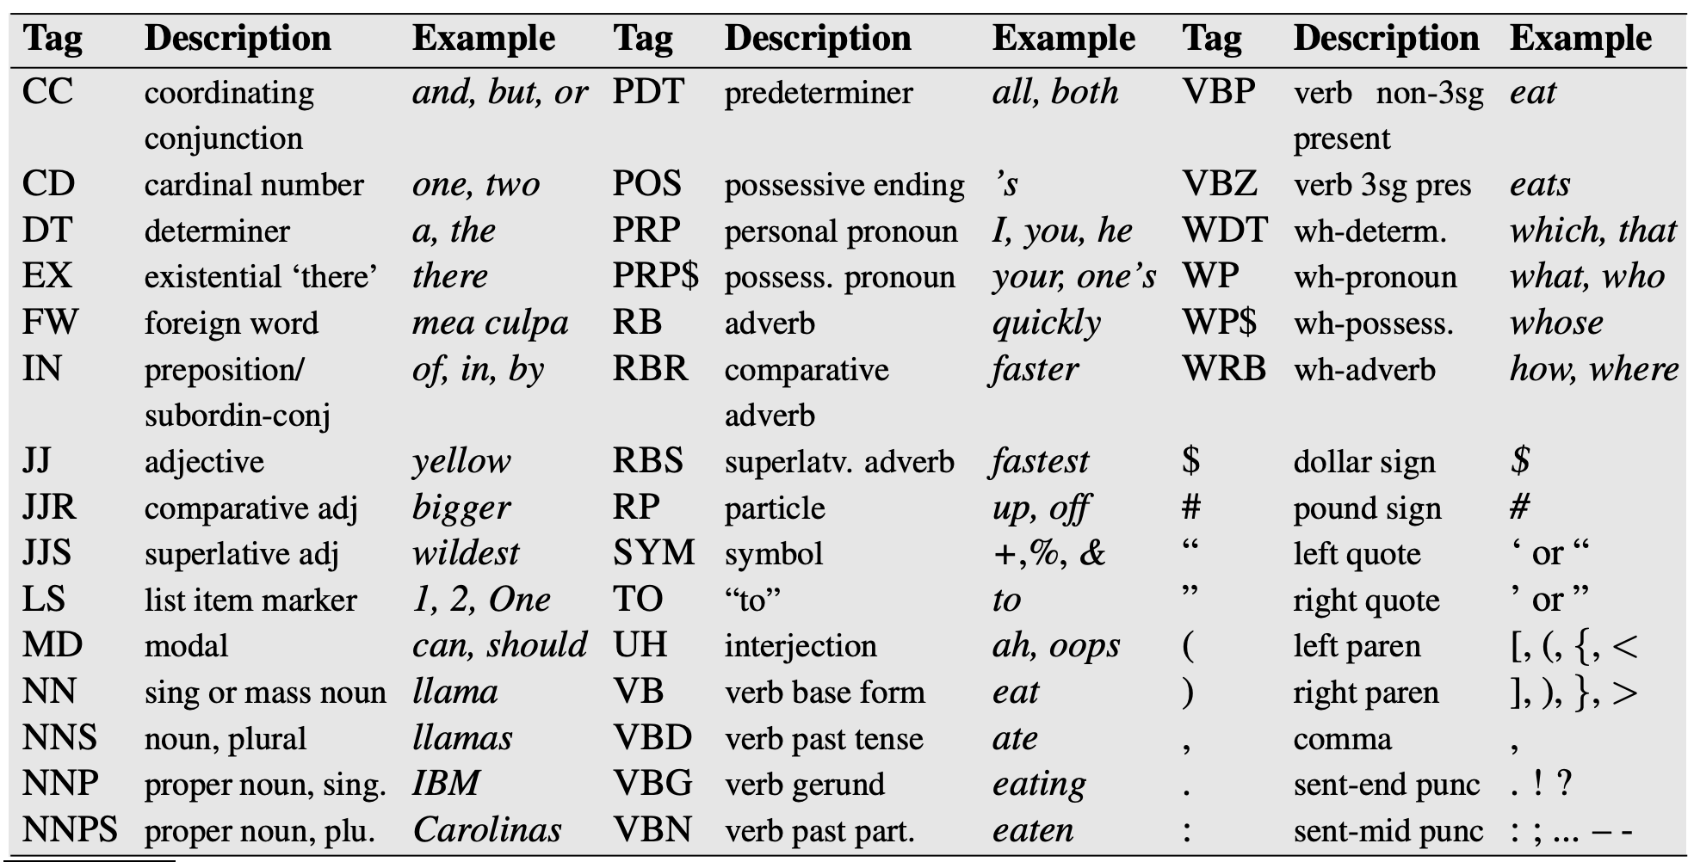
1.1 Part-Of-Speech
Parts of speech (POS): word classes or syntactic categories
noun, verb, pronoun, preposition, adverb, conjunction, participle, and article
Example: The Penn TreeBank
Marcus, Mitchell, et al. "The Penn Treebank: annotating predicate argument structure." Proceedings of the workshop on Human Language Technology. Association for Computational Linguistics, 1994.
Notes:
One of the simplest grammar is part-of-speech.
Parts of speech tries to categorize words into different categories, such as noun, verb and adjectives.
The eight most important part of speech tags are listed here.
The Penn TreeBank further partition the eight coarse grained tags into 45 fine-grained tags.
For example, the Penn TreeBank further split the Verb tag into VB: verb base form, VBD: verb past tense, VBG: Verb Gerund which means present tense.

Slide 5
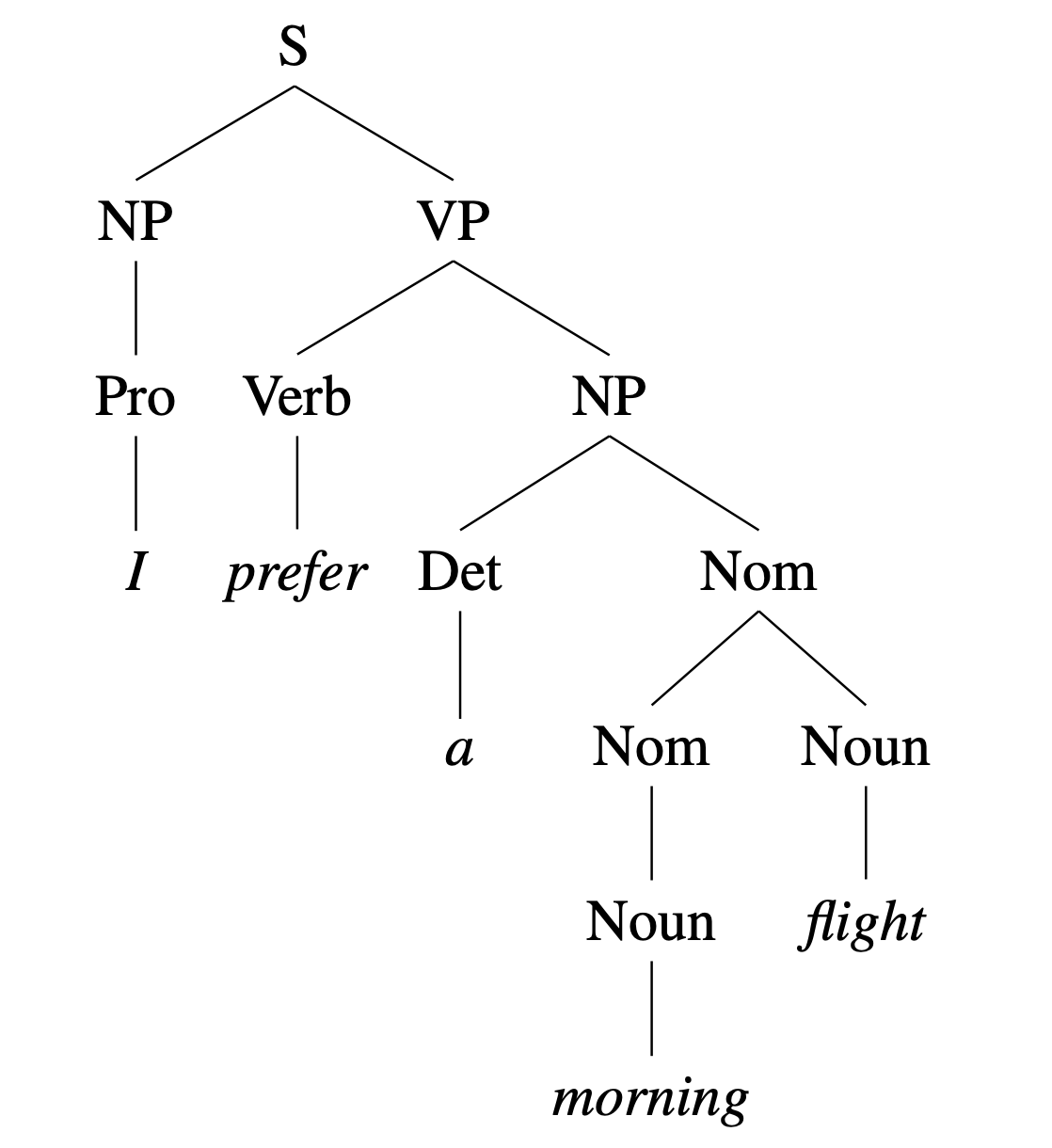
1.2 Constituency Tree
Constituency: abstraction for groups of words -> hierarchical graph.
I prefer a morning flight
S: Sentence
NP: Noun Phrase
VP: Verb Phrase
Pro: Pronoun
Det: Determiner
Nom: Nominal Noun
PRP VBP DT NN NN
PRP: Personal Pronoun
VBP: Verb Present
DT: Determiner
NN: Single or Mass Noun
Jurafsky, Daniel, and James H. Martin. "Speech and Language Processing: An introduction to speech recognition, computational linguistics and natural language processing." Upper Saddle River, NJ: Prentice Hall (2008).
Notes:
Part of speech doesn’t consider the hierarchy of words. It doesn’t consider noun phrase, verb phrase etc.
The fundamental notion underlying the idea of constituency is that of abstraction — groups of words behaving as single units, or constituents.

Slide 6
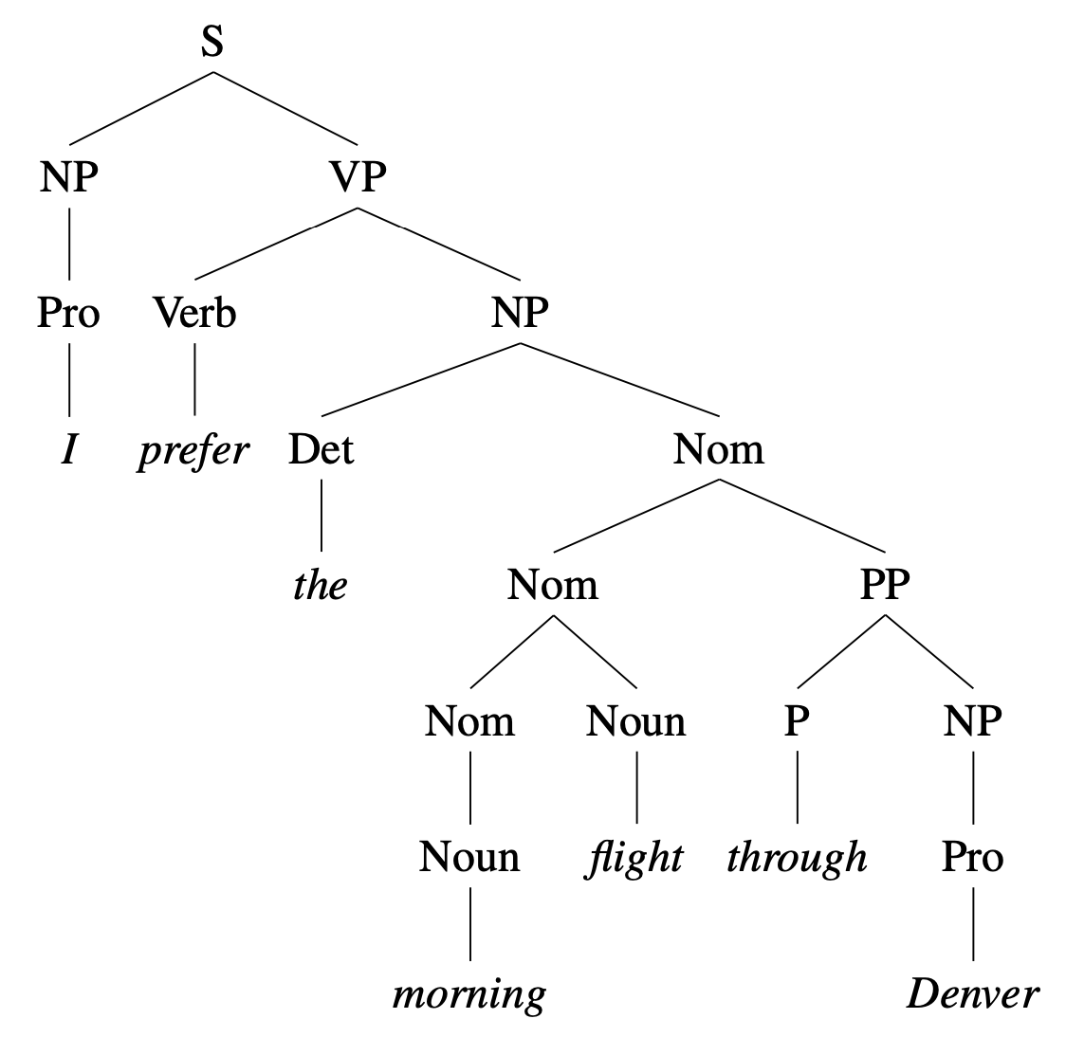
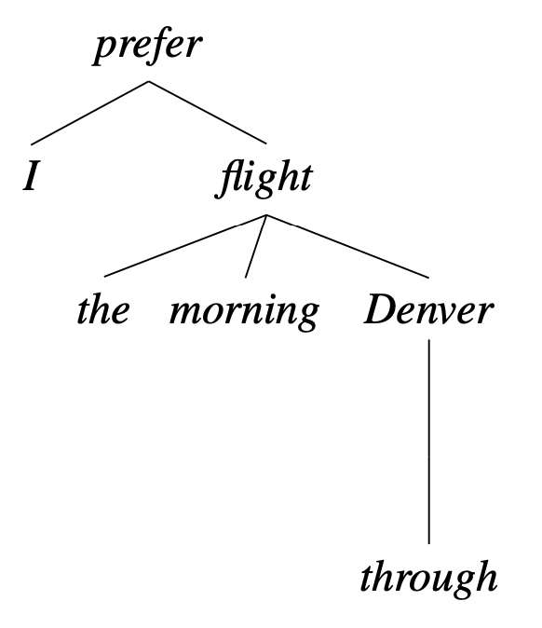
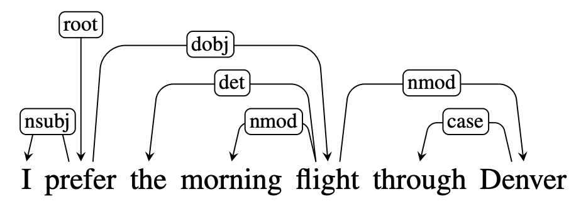
1.3 Dependency Tree
Dependency: relation between a pair of words -> dependency tree.
root
nsubj: nominal subject
dobj: direct object
det: determiner
nmod: nominal modifier
case: prepositions etc.
Important property: DAG constrain
(Directed Acyclic Graph)
Jurafsky, Daniel, and James H. Martin. "Speech and Language Processing: An introduction to speech recognition, computational linguistics and natural language processing." Upper Saddle River, NJ: Prentice Hall (2008).
Notes:
Dependency parsing is another very important formalism in modern natural language processing, which mainly considers the relation between words.

Slide 7
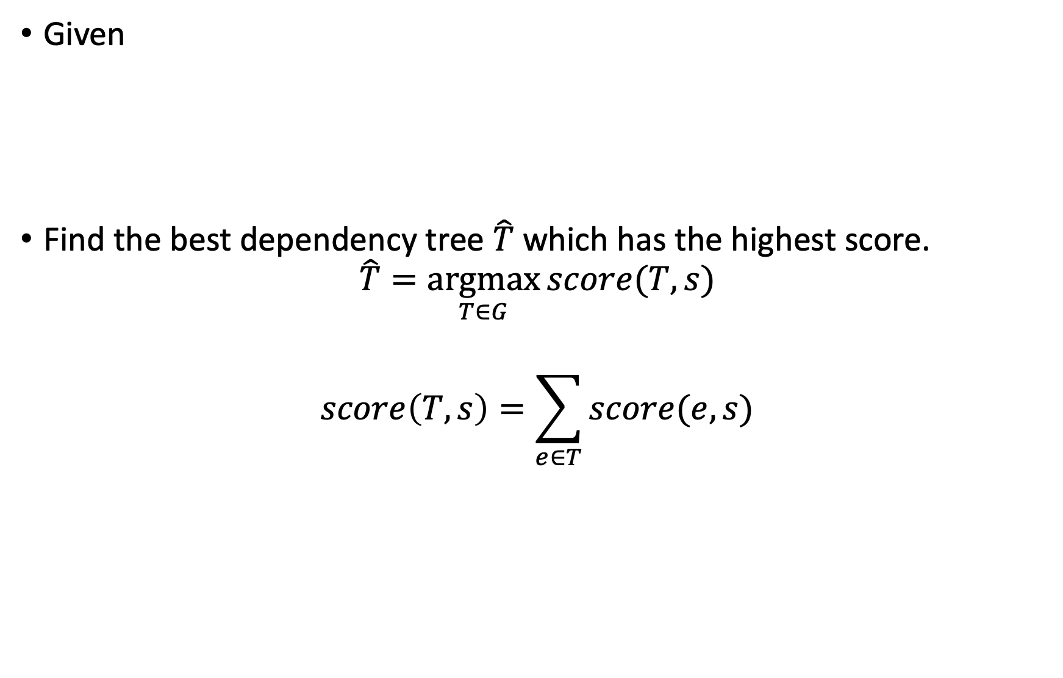
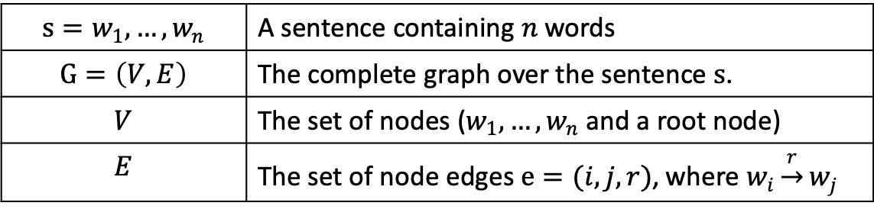
2. Dependency Parsing via Graph Algorithm
Given
Find the best dependency tree $\hat{T}$ which has the highest score.
$$\hat{T}=\underset{T∈G}{argmax}{score(T, s)}$$
$$score\left(T, s\right)=\sum_{e∈T}{score(e, s)}$$
$$s=w_{1}, …,w_{n}$$ | A sentence containing $n$ words
$$G=\left(V, E\right)$$ | The complete graph over the sentence $s$.
$$V$$ | The set of nodes ($w_{1}, …,w_{n}$ and a root node)
$$E$$ | The set of node edges $e=(i, j, r)$, where $w_{i}\underset{→}{r}w_{j}$

Slide 8
2. Dependency Parsing via Graph Algorithm
Two steps for solving the problem:
Compute scores for each edge. (*main focus of the paper)
Infer dependency tree based on the estimated edge scores.
Search for optimal tree (without edge labels)
Predict edge labels

Slide 9
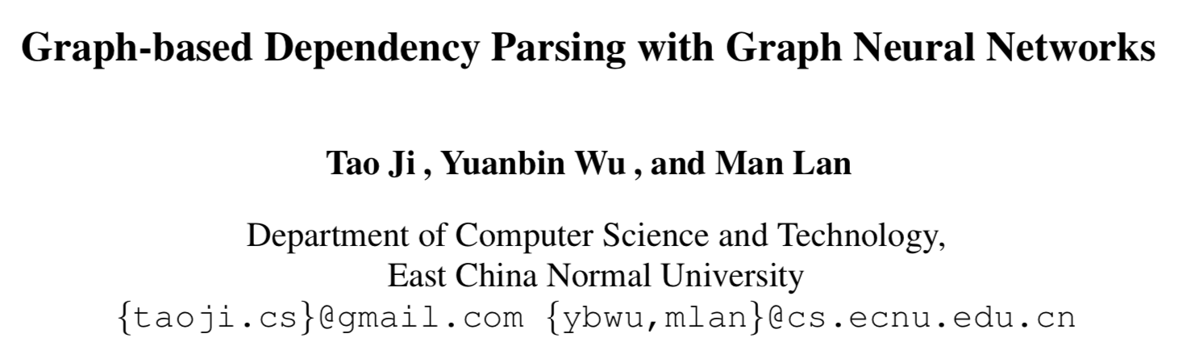
3. The paper

Slide 10
3.1 Motivation
Previous work has shown first-order relations can help learning.
Head and dependent vector.
Introduce structure knowledge into node representations.
Especially high-order relations (e.g. grandparents)
Graph neural network to capture long-term dependencies.

Slide 11
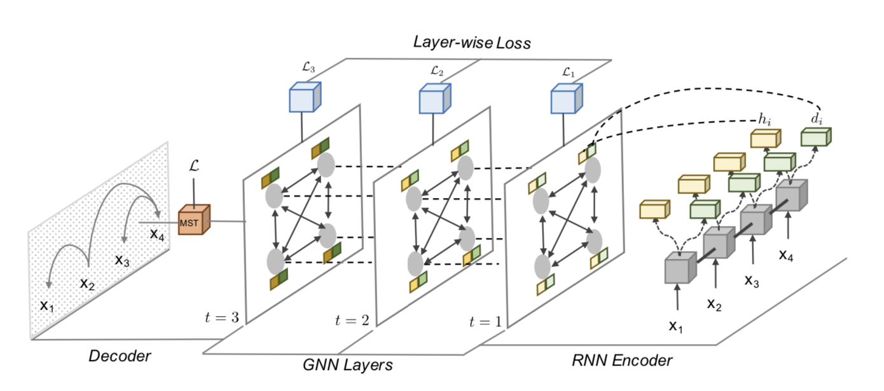
3.2 Overview
Loss for predicting edge scores
Loss for tree structures and edge labels
Infer optimal tree given a complete graph with edge scores.
Encode high-order information and predict edge scores
Basic node representations

Slide 12
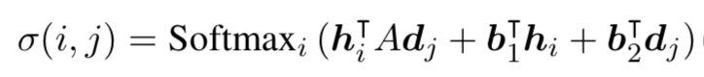
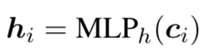
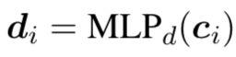
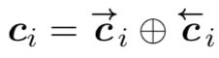
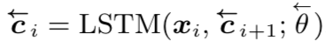
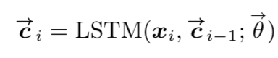
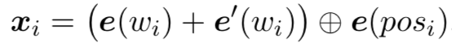
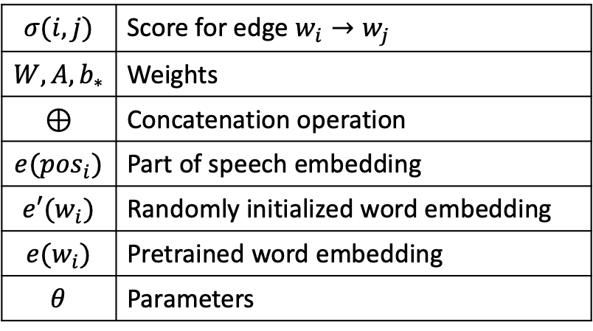
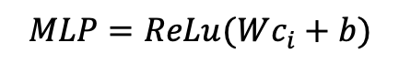
3.3 RNN Encoder
$$σ(i,j)$$ | Score for edge $w_{i}→w_{j}$
$$W,A,b_{∗}$$ | Weights
⊕ | Concatenation operation
$$e({pos}_{i})$$ | Part of speech embedding
$$e′(w_{i})$$ | Randomly initialized word embedding
$$e(w_{i})$$ | Pretrained word embedding
$$θ$$ | Parameters
$$MLP=ReLu(Wc_{i}+b)$$
…
…

Slide 13
Overview
Loss for predicting edge scores
Loss for tree structures and edge label classification
Infer optimal tree given a complete graph with edge scores.
Encoding high-order information
Basic node representations

Slide 14
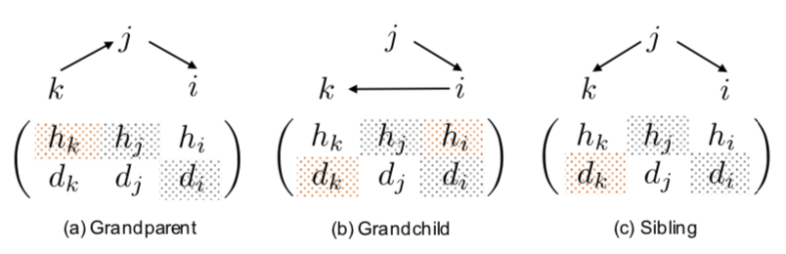
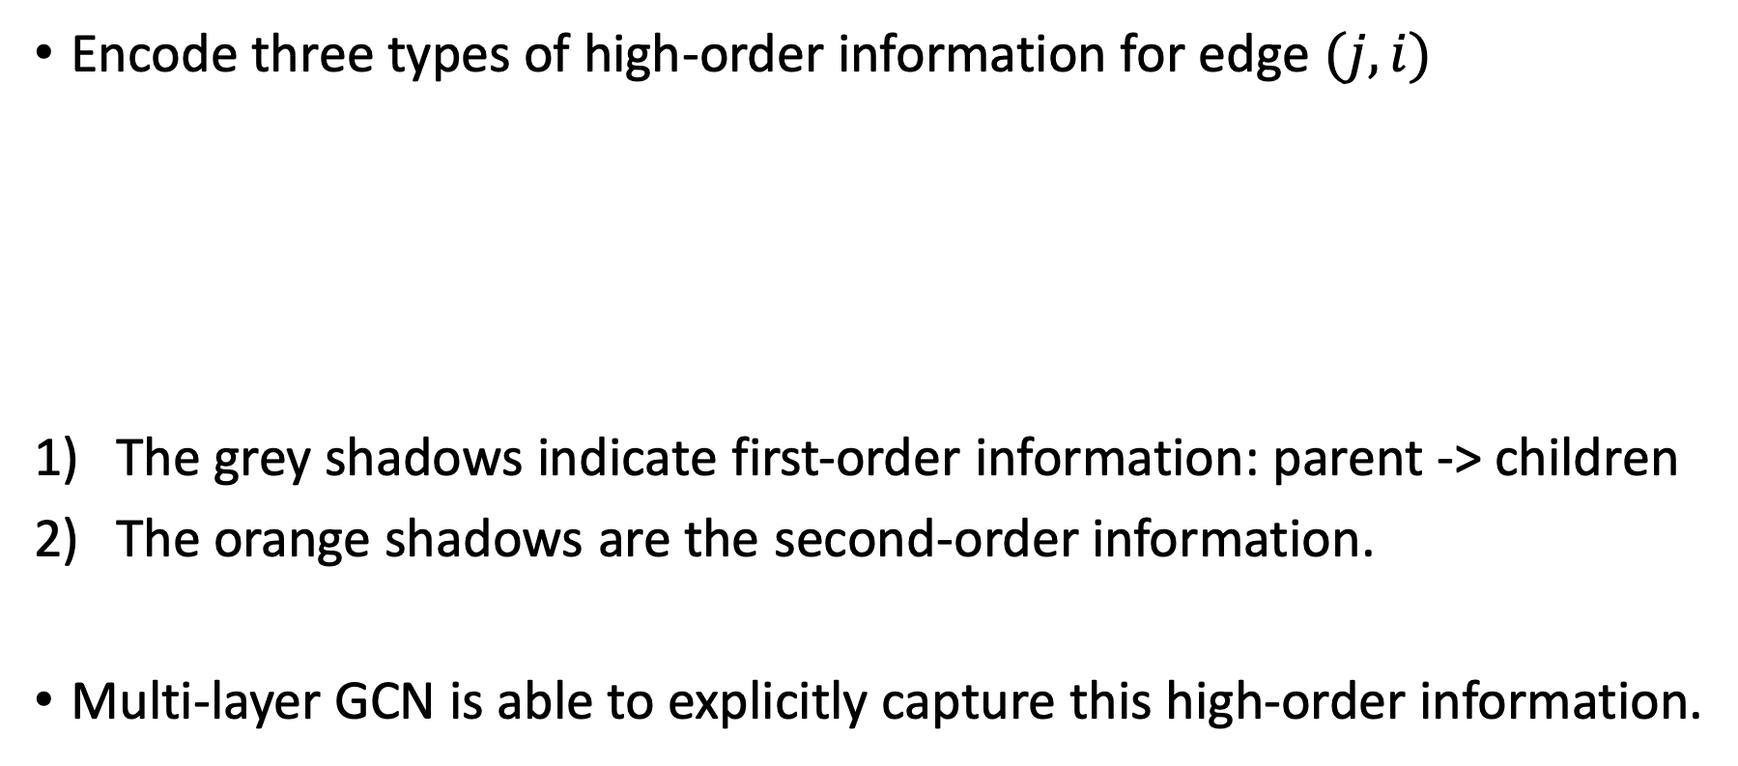
3.4 GNN Layers
Encode three types of high-order information for edge $(j,i)$
The grey shadows indicate first-order information: parent -> children
The orange shadows are the second-order information.
Multi-layer GCN is able to explicitly capture this high-order information.

Slide 15
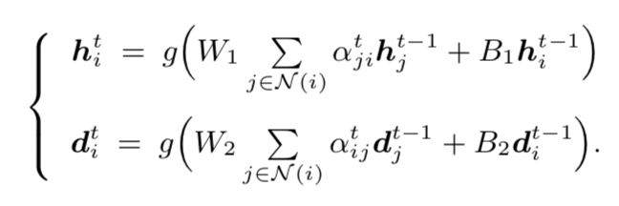
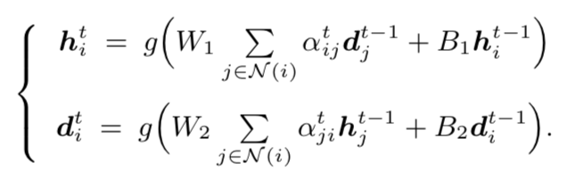
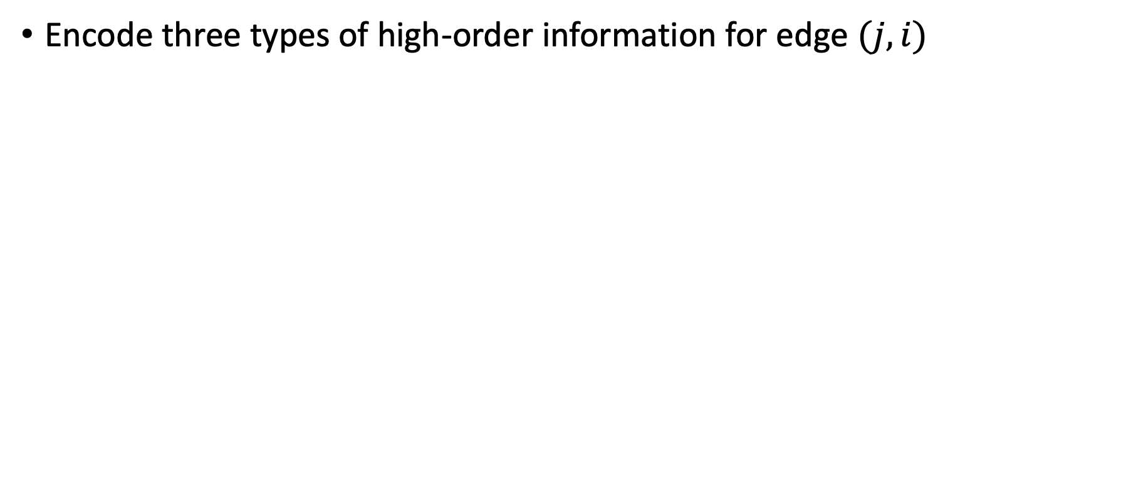
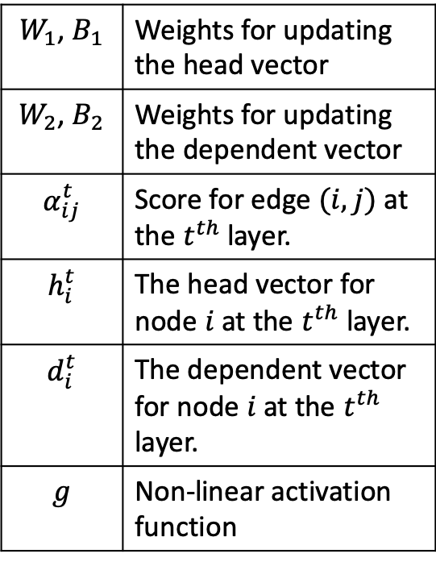
3.4 GNN Layers (cont’)
Encode three types of high-order information for edge $(j,i)$
$W_{1}$, $B_{1}$ | Weights for updating the head vector
$W_{2}$, $B_{2}$ | Weights for updating the dependent vector
$$α_{ij}^{t}$$ | Score for edge $(i, j)$ at the $t^{th}$ layer.
$$h_{i}^{t}$$ | The head vector for node $i$ at the $t^{th}$ layer.
$$d_{i}^{t}$$ | The dependent vector for node $i$ at the $t^{th}$ layer.
$$g$$ | Non-linear activation function

Slide 16
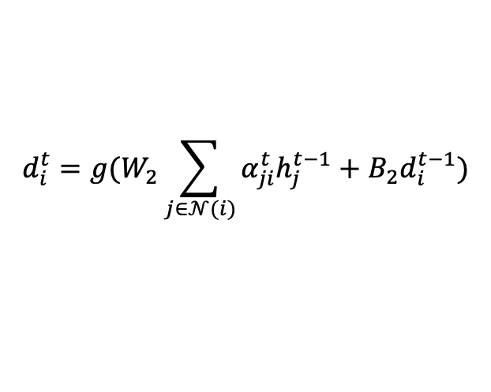
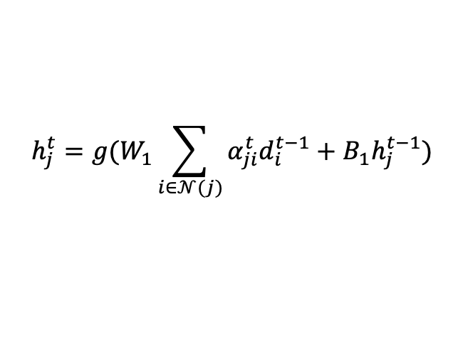
3.4 GNN Layers – My understanding
How to gather information of neighbors?
Head nodes: gather information from neighbors’ dependent nodes.
Dependent nodes: gather information from neighbors’ head nodes.
$$h_{j}^{t}=g(W_{1}\sum_{i∈𝒩(j)}{α_{ji}^{t}d_{i}^{t−1}+B_{1}h_{j}^{t−1}})$$
$$d_{i}^{t}=g(W_{2}\sum_{j∈𝒩(i)}{α_{ji}^{t}h_{j}^{t−1}+B_{2}d_{i}^{t−1}})$$

Slide 17
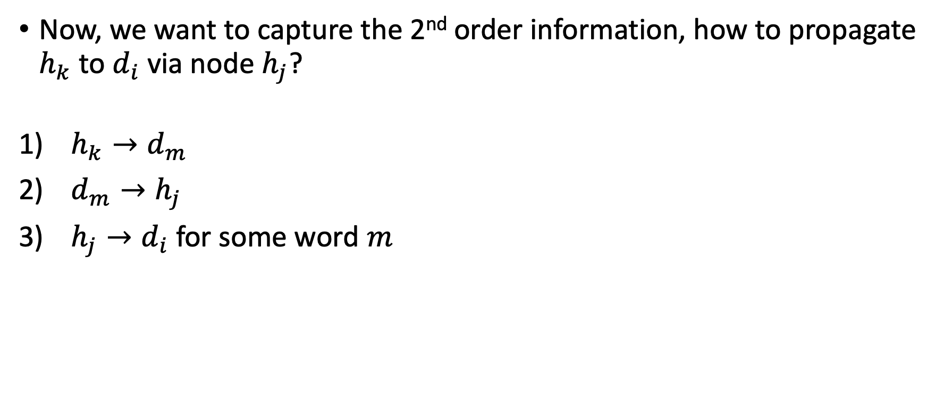
3.4 GNN Layers – My understanding (cont’)
Now, we want to capture the 2nd order information, how to propagate $h_{k}$ to $d_{i}$ via node $h_{j}$?
$h_{k}→d_{m}$
$d_{m}→h_{j}$
$h_{j}→d_{i}$ for some word $m$
Conclusion: unable to directly capture the 2nd order information.

Slide 18
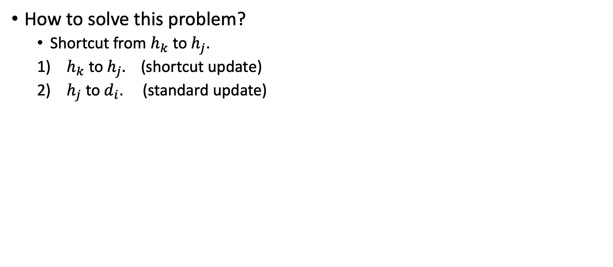
3.4 GNN Layers – My understanding (cont’)
How to solve this problem?
Shortcut from $h_{k}$ to $h_{j}$.
$h_{k}$ to $h_{j}.$ (shortcut update)
$h_{j}$ to $d_{i}$. (standard update)

Slide 19
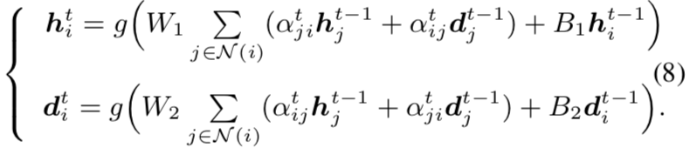
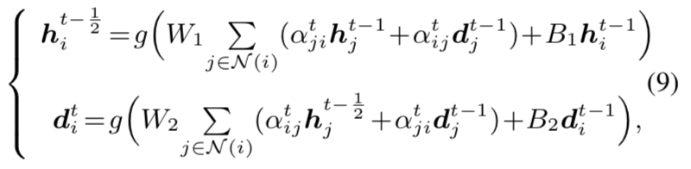
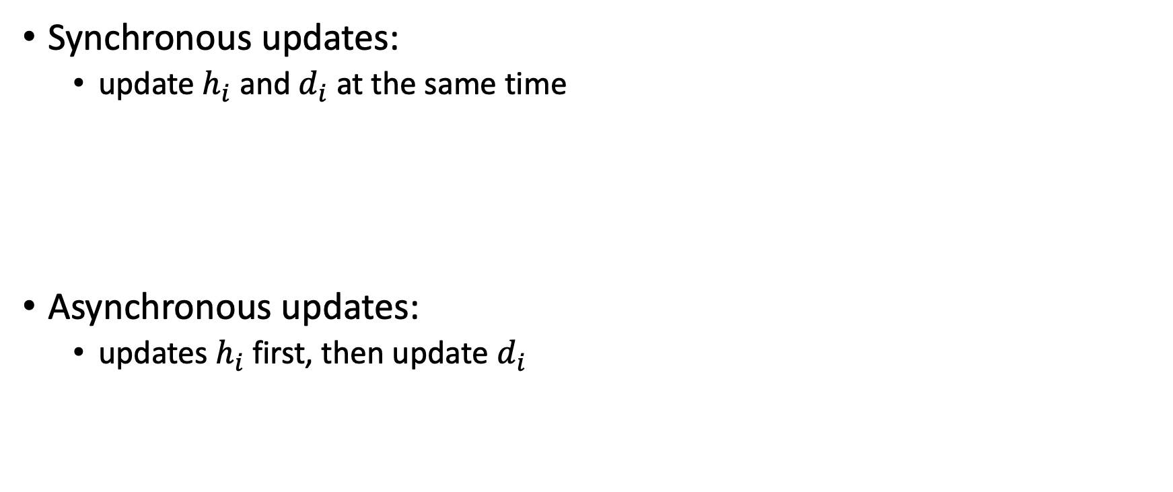
3.4 GNN Layers – Put updating functions together
Synchronous updates:
update $h_{i}$ and $d_{i}$ at the same time
Asynchronous updates:
updates $h_{i}$ first, then update $d_{i}$

Slide 20
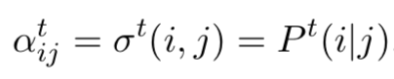
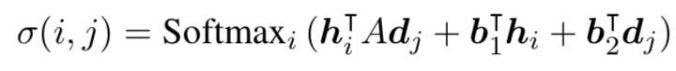
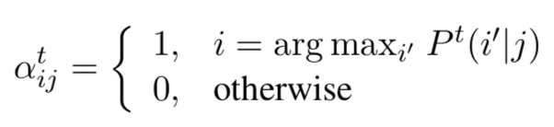
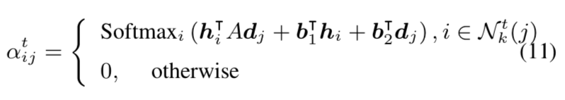
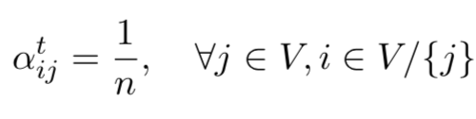
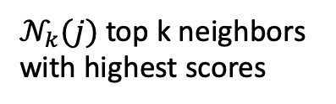
3.4 GNN Layers – Edge scores
Soft scores:
{0, 1} scores:
Top k scores:
Average:
$𝒩_{k}(j)$ top k neighbors with highest scores

Slide 21
Overview
Loss for predicting edge scores
Loss for tree structures and edge label classification
Infer optimal tree given a complete graph with edge scores.
Encoding high-order information
Basic node representations

Slide 22
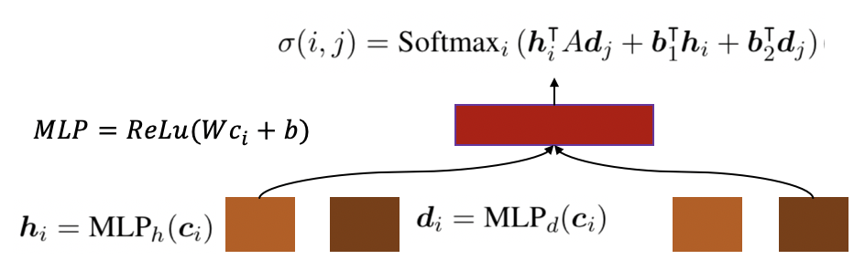
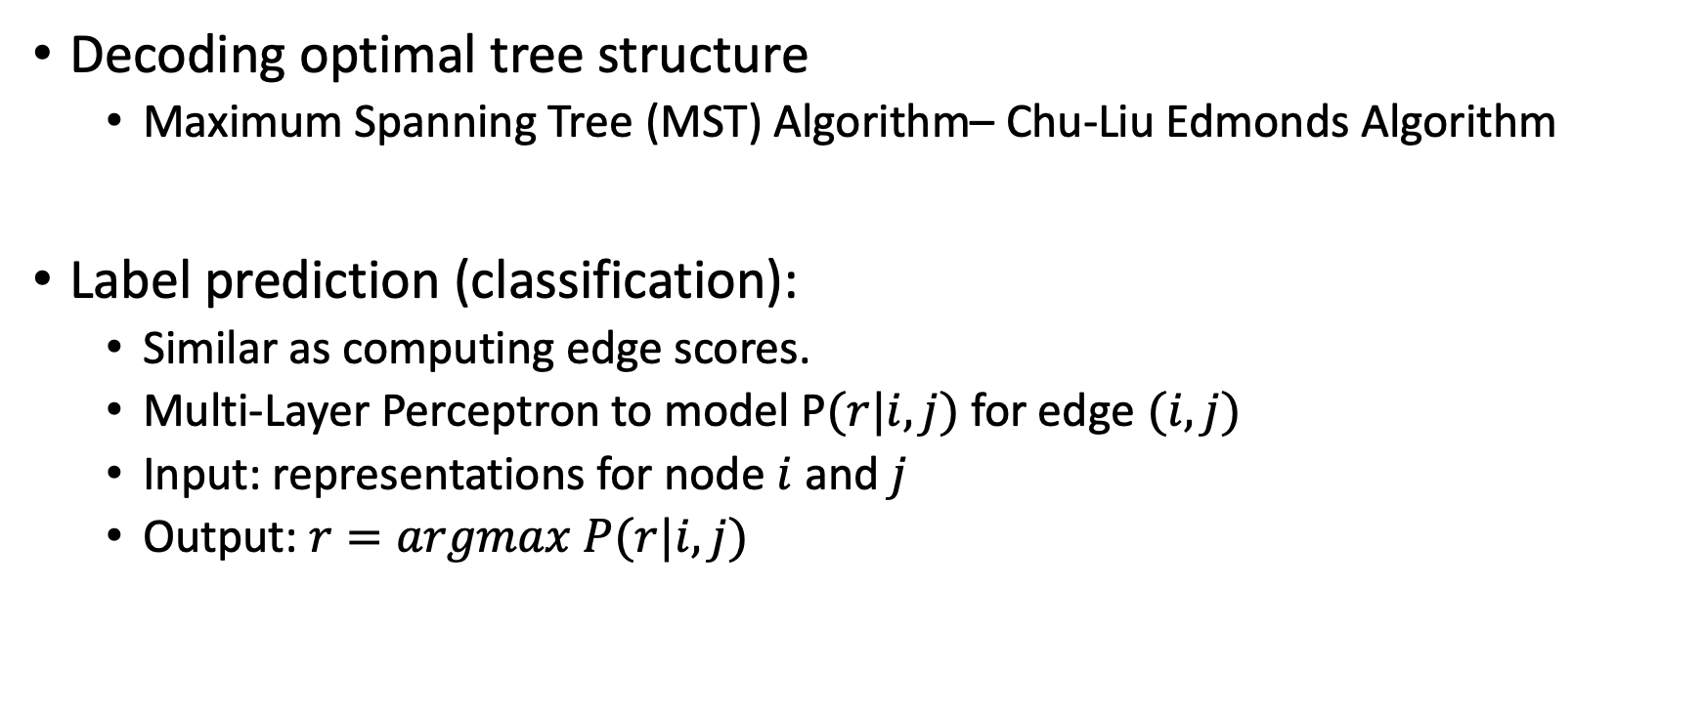
3.5 Decoding Optimal Tree
Decoding optimal tree structure
Maximum Spanning Tree (MST) Algorithm– Chu-Liu Edmonds Algorithm
Label prediction (classification):
Similar as computing edge scores.
Multi-Layer Perceptron to model P$(r|i,j)$ for edge $(i,j)$
Input: representations for node $i$ and $j$
Output: $r=argmax P(r|i, j)$

Slide 23
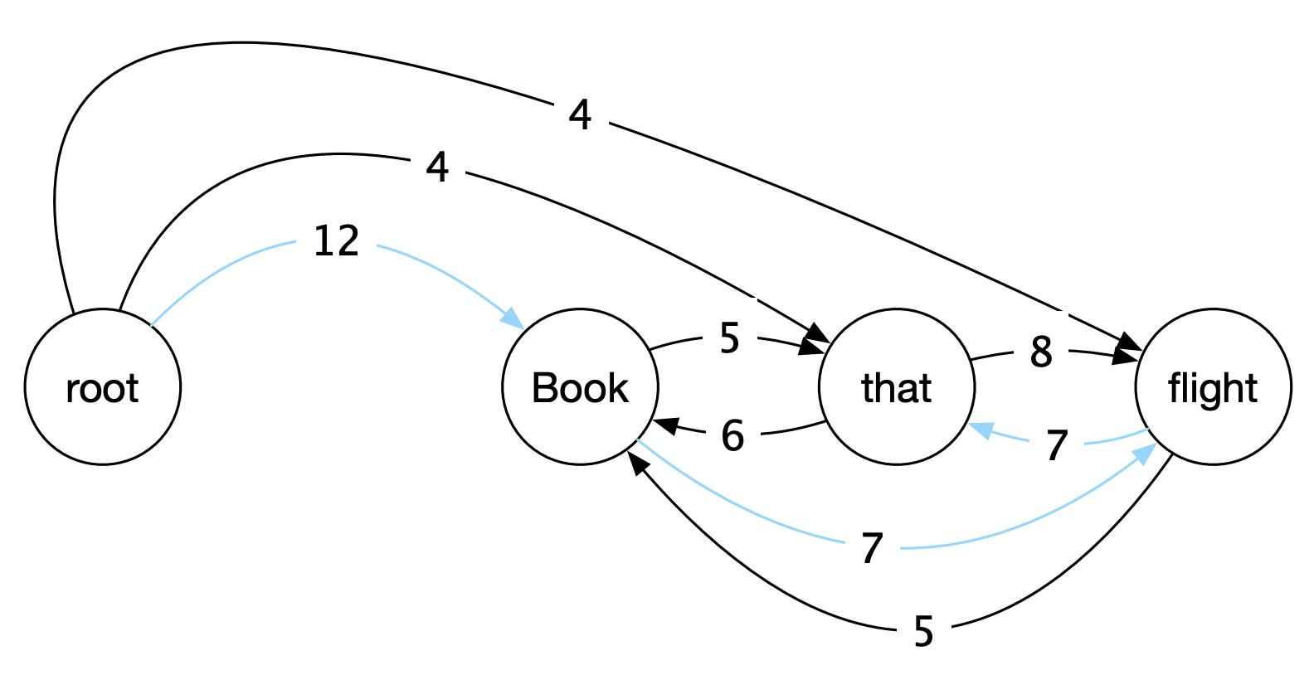
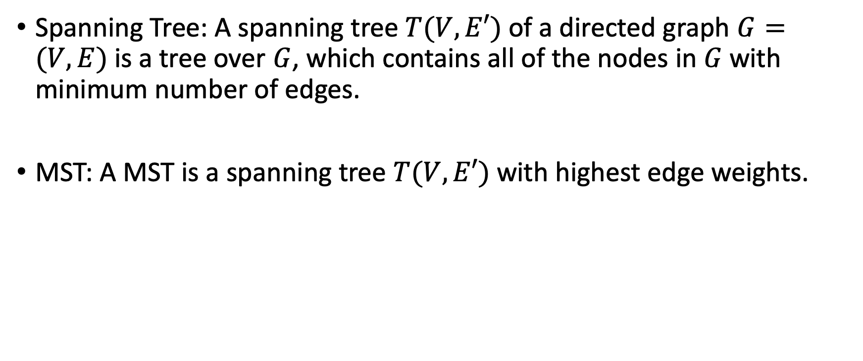
3.5.1 Maximum Spanning Tree (MST)
Spanning Tree: A spanning tree $T(V, E′)$ of a directed graph $G=(V, E)$ is a tree over $G$, which contains all of the nodes in $G$ with minimum number of edges.
MST: A MST is a spanning tree $T(V, E′)$ with highest edge weights.
Jurafsky, Daniel, and James H. Martin. "Speech and Language Processing: An introduction to speech recognition, computational linguistics and natural language processing." Upper Saddle River, NJ: Prentice Hall (2008).

Slide 24
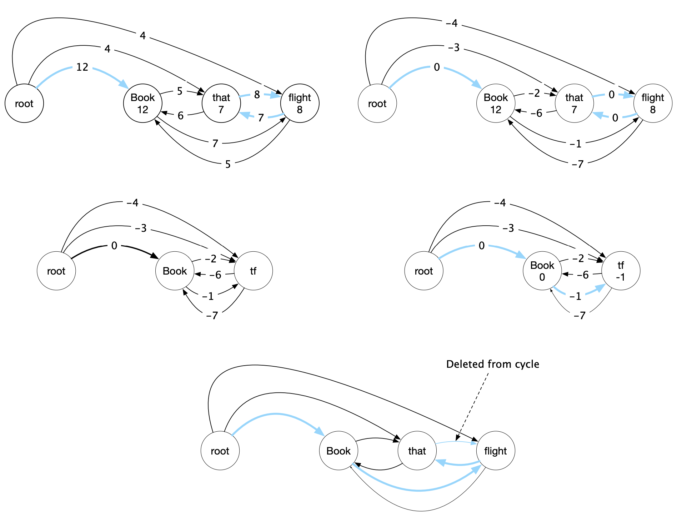
3.5.2 Chu-Liu Edmonds Algorithm
Initialization: for each v, choose the incoming edge with highest score.
Break cycles: subtract highest scores for all incoming edges, and merge nodes in cycles.
Split nodes, and delete edges according to Tree constrain.
Step 1
Step 2
Step 2
Step 1’
Step 3
Jurafsky, Daniel, and James H. Martin. "Speech and Language Processing: An introduction to speech recognition, computational linguistics and natural language processing." Upper Saddle River, NJ: Prentice Hall (2008).

Slide 25
Overview
Loss for predicting edge scores
Loss for tree structures and edge label classification
Infer optimal tree given a complete graph with edge scores.
Encoding high-order information
Basic node representations

Slide 26
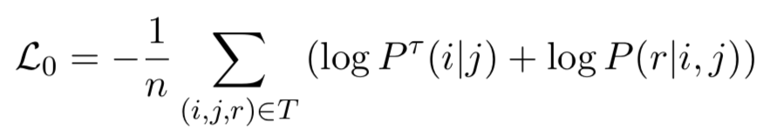
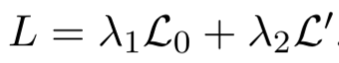
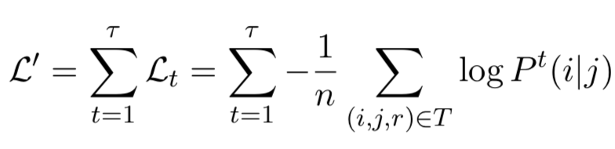
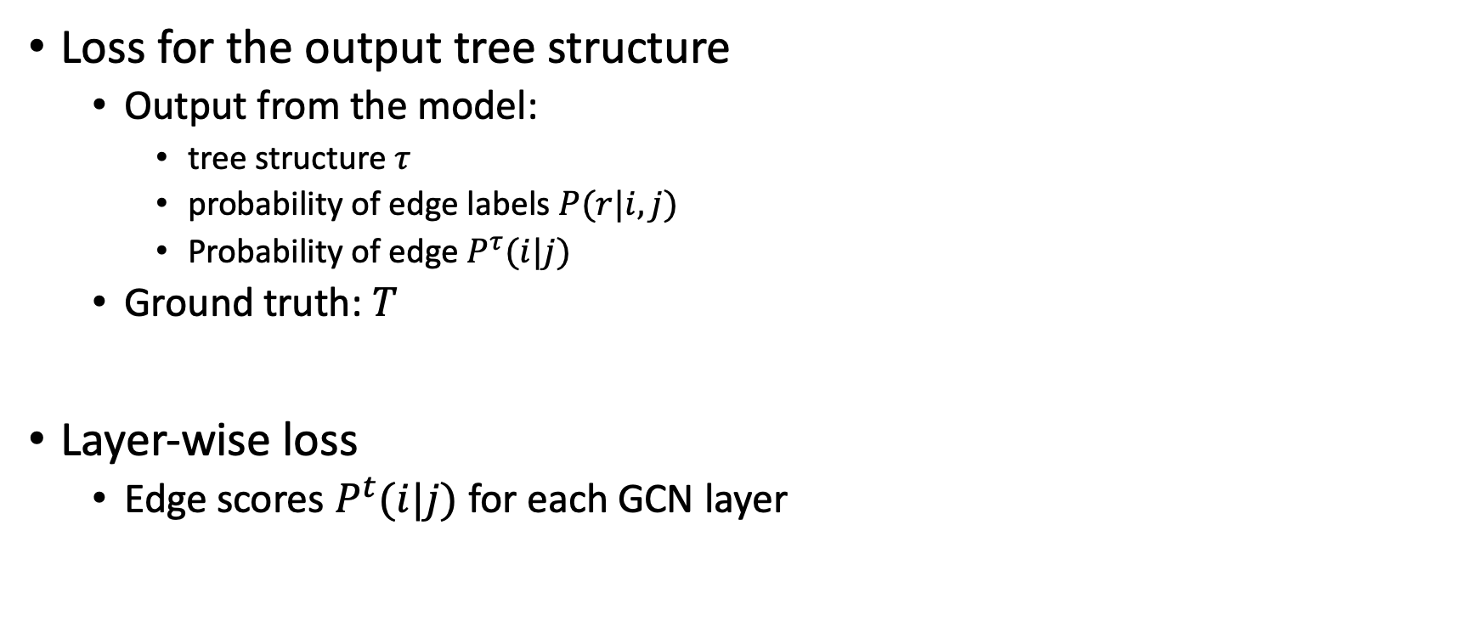

3.5.3 Learning Objective
Loss for the output tree structure
Output from the model:
tree structure $τ$
probability of edge labels $P(r|i,j)$
Probability of edge $P^{τ}(i|j)$
Ground truth: $T$
Layer-wise loss
Edge scores $P^{t}(i|j)$ for each GCN layer
$n$: the number of edges in $T$

Slide 27
3.6 Experimental Results
Unlabeled Attachment Score (UAS):
The percentage of words that have the corrected head.
Labeled Attachment Score (LAS):
The percentage of words that have the corrected head and label.
Unlabeled Complete Match (UCM):
The percentage of predicted trees that are completely corrected.
Labeled Complete Match (LCM):
The percentage of predicted trees and labels are completely corrected.
Jurafsky, Daniel, and James H. Martin. "Speech and Language Processing: An introduction to speech recognition, computational linguistics and natural language processing." Upper Saddle River, NJ: Prentice Hall (2008).

Slide 28

3.6.1 Main Results

Slide 29


3.6.2 Different Layers and Updating Methods

Slide 30

3.6.2 Different Layers and Updating Methods

Slide 31

3.6.3 Different Scoring Functions

Slide 32

3.6.4 Error Analysis

Slide 33
References
Jurafsky, Daniel, and James H. Martin. "Speech and Language Processing: An introduction to speech recognition, computational linguistics and natural language processing." Upper Saddle River, NJ: Prentice Hall (2008).
Marcus, Mitchell, et al. "The Penn Treebank: annotating predicate argument structure." Proceedings of the workshop on Human Language Technology. Association for Computational Linguistics, 1994.
Ji, Tao, Yuanbin Wu, and Man Lan. "Graph-based dependency parsing with graph neural networks." Proceedings of ACL. 2019.

